Slide 1



Noida Institute of Engineering and Technology, Greater Noida
Introduction
UNIT 1
Unit: 1
BLOCKCHAIN TECHNOLOGY AND
APPLICATION DEVELOPMENT (ACSAI0601)
Ms. Barkha Bhardwaj Assistant Professor
B.Tech AI
Course Details (B Tech 6th Sem)

Slide 2
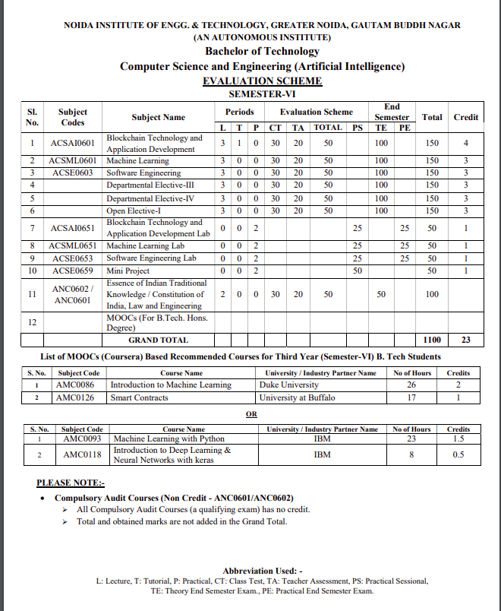
Noida Institute of Engineering and Technology, Greater Noida

Slide 3
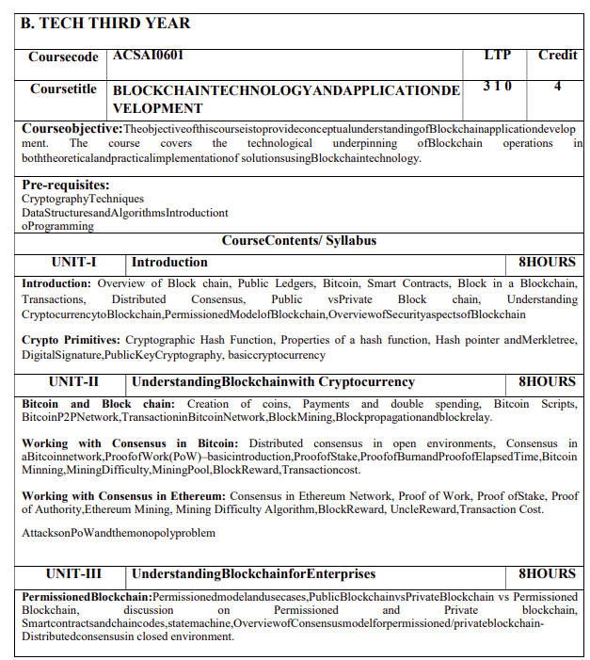
Noida Institute of Engineering and Technology, Greater Noida
Syllabus

Slide 4
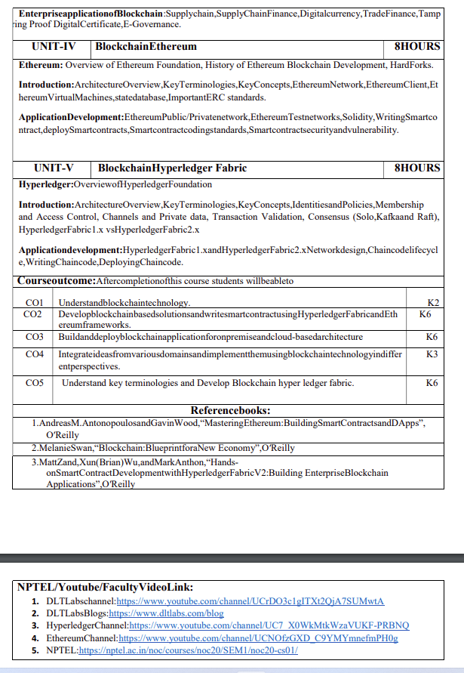
Noida Institute of Engineering and Technology, Greater Noida
Syllabus

Slide 5
Branch Wise Applications
It can compute man-made problems as well as natural phenomena. Block Chain theory has a lot of applications in real life as well, such that in SCM,education ,security ,banking and many fields.

Slide 6
Course Objective
To assess blockchain applications in a structured manner.
To impart knowledge in block chain techniques and able to present the concepts clearly and structured.
To get familiarity with future currencies and to create own crypto token.

Slide 7
Course Outcome
Course Outcome (CO) |  | Bloom’s Knowledge Level (KL)
At the end of the course, the student will be able to understand
CO 1 | Understand block chain technology. |  | K2
CO 2 | Develop block chain based solutions and write smart contract using Hyper ledger Fabric and Ethereum frameworks. |  | K6
CO 3 | Buildanddeployblockchainapplicationforonpremiseandcloud-basedarchitecture |  | K6
CO 4 | Integrate ideas from various domains and implement them using block chain technology in differ ent perspectives. |  | K3
CO 5 | Understand key terminologies and Develop Block chain hyper ledger fabric. |  | K6

Slide 8
Program Outcomes
Engineering Graduates will be able to Understand:
1. Engineering knowledge
2. Problem analysis
3. Design/development of solutions
4. Conduct investigations of complex
5. Modern tool usage
6. The engineer and society
7. Environment and sustainability
8. Ethics
9. Individual and team work
10. Communication
11. Project management and finance
12. Life-long learning

Slide 9
CO-PO and PSO Mapping
CO-PO correlation matrix of Block Chain and Application Development(ACSAI0601)
 | PO1 | PO2 | PO3 | PO4 | PO5 | PO6 | PO7 | PO8 | PO9 | PO10 | PO11 | PO12
ACSAI0601 | 2 | 2 | 3 | 3 | 2 | 2 | - | - | 2 | 1 | - | 3
ACSAI0601 | 1 | 3 | 2 | 3 | 2 | 2 | - | 1 | 1 | 1 | 2 | 2
ACSAI0601 | 2 | 2 | 3 | 2 | 2 | 2 | - | 2 | 2 | 1 | 2 | 3
ACSAI0601 | 2 | 2 | 2 | 3 | 2 | 2 | - | 2 | 2 | 1 | 1 | 3
ACSAI0601 | 3 | 2 | 2 | 2 | 2 | 2 | - | 2 | 1 | 1 | 1 | 2
Average | 2 | 2.2 | 2.4 | 2.6 | 2 | 2 | - | 1.4 | 1.6 | 1 | 1.2 | 2.6
Mapping of Program Specific Outcomes and Course Outcomes:

Slide 10
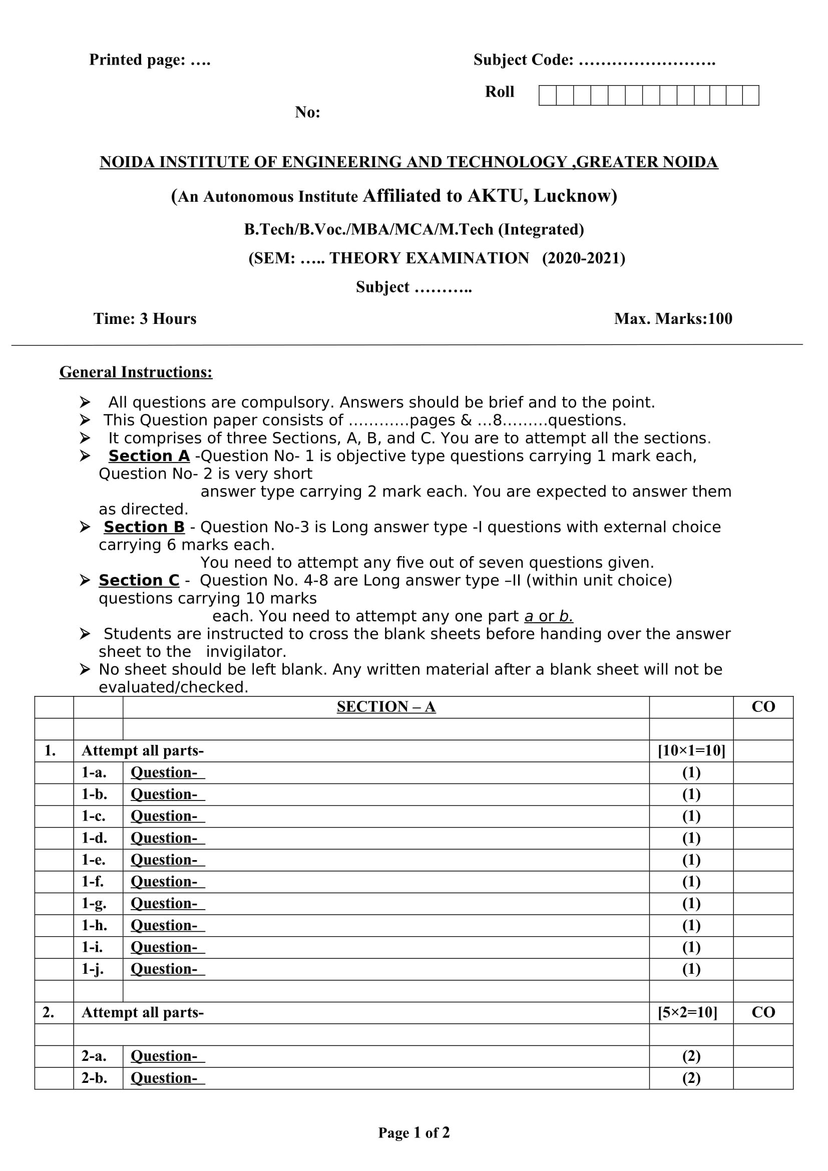
End Semester Question Paper Templates (Offline Pattern/Online Pattern)
End Semester Question Paper Templates (Offline Pattern/Online Pattern)

Slide 11
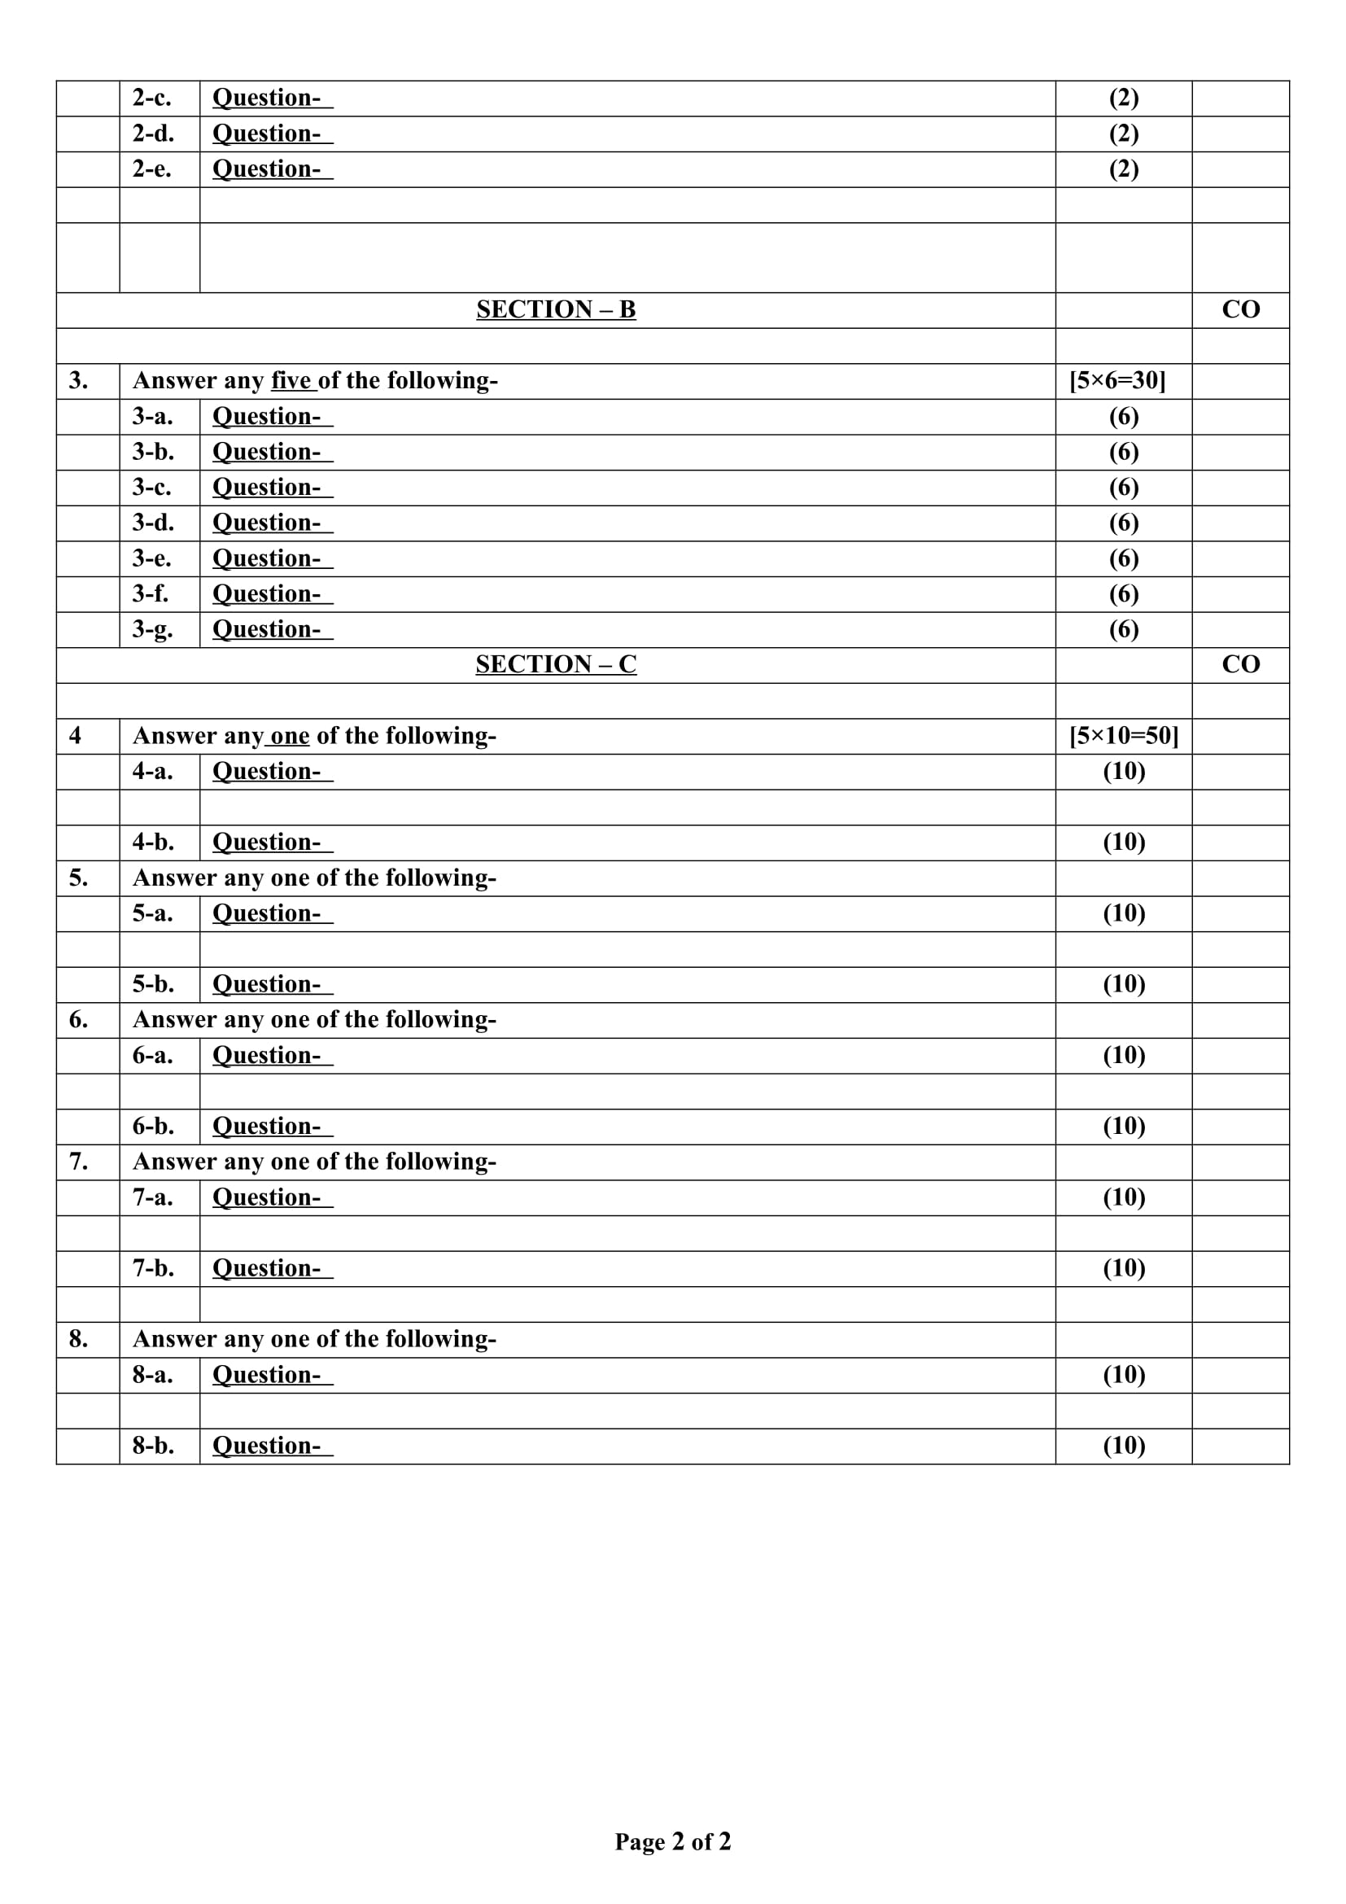
End Semester Question Paper Templates (Offline Pattern/Online Pattern)

Slide 12
Prerequisite and Recap
Brief input about the block chain and its introduction in the different fields. The basics of the Cyber security and cryptography are the requirements of this course.

Slide 13
Brief Introduction about the Subject with videos
Blockchain is a buzzword in today’s technology and this technology is described as the most disruptive technology of the decade.
Thus, Blockchain is used for the secure transference of items like money, contracts, property rights, stocks, and even networks without any requirement of Third Party Intermediaries like Governments, banks, etc.
DLTLabschannel:https://www.youtube.com/channel/UCrDO3c1gITXt2QjA7SUMwtA
DLTLabsBlogs:https://www.dltlabs.com/blog
HyperledgerChannel:https://www.youtube.com/channel/UC7_X0WkMtkWzaVUKF-PRBNQ
EthereumChannel:https://www.youtube.com/channel/UCNOfzGXD_C9YMYmnefmPH0g
NPTEL:https://nptel.ac.in/noc/courses/noc20/SEM1/noc20-cs01/

Slide 14
Contents
Introduction
Overview of Block chain
Distributed Consensus
Public vs Private Block chain
Cryptographic Hash Function
Hash pointer and Merkle tree
Digital Signature
Public Key Cryptography
Basic cryptocurrency

Slide 15
Unit Objective
To understand the basic concept of the block chain.
To understand the concepts of the cryptocurrency.
To understand the cryptographic hash functions.
To understand the Public key cryptography.

Slide 16
Unit I Syllabus
Introduction :
Overview of Block chain, Public Ledgers, Bitcoin, Smart Contracts, Block in a Block chain, Transactions, Distributed Consensus, Public vs Private Block chain.
Permissioned Model of Blockchain ,Overview of Security aspects of Block chain Crypto Primitives: Cryptographic Hash Function, Properties of a hash function, Hash pointer and Merkletree, Digital Signature, Public Key Cryptography, basic cryptocurrency

Slide 17
Introduction : Overview of Block chain(CO1)
Block chain is a secure series or chain of timestamped records stored in a database that a group of users manages who are a part of a decentralized network. Block chain is a decentralized or distributed ledger where each node in the network has access to the data or records stored in a block chain.
The encryption of all the important data records in the block chain is done using cryptographic techniques. This ensures the security of the data in the block chain.
A block chain is an open, distributed ledger that can record transactions between two parties efficiently and in a verifiable and permanent way without the need for a central authority.

Slide 18
Introduction (CO1)
Key Characteristics:
Building trust with Blockchain: Blockchain enhances trust across a business network. It’s not that you can’t trust those who you conduct business with its that you don’t need to when operating on a Blockchain network. Blockchain builts trust through the following five attributes:
Distributed: The distributed ledger is shared and updated with every incoming transaction among the nodes connected to the Blockchain. All this is done in real-time as there is no central server controlling the data.
Secure: There is no unauthorized access to Blockchain made possible through Permissions and Cryptography.
Transparent: Because every node or participant in Blockchain has a copy of the Blockchain data, they have access to all transaction data. They themselves can verify the identities without the need for mediators.
Consensus-based: All relevant network participants must agree that a transaction is valid. This is achieved through the use of consensus algorithms.
Flexible: Smart Contracts which are executed based on certain conditions can be written into the platform. Blockchain Network can evolve in pace with business processes.

Slide 19
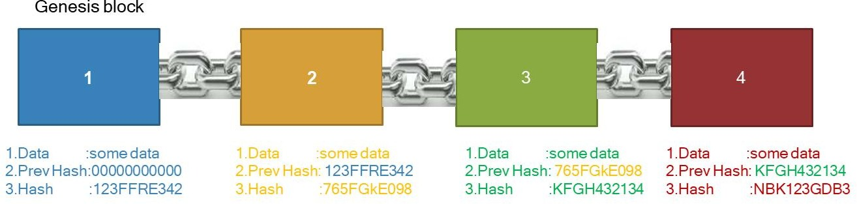
Introduction (CO1)
A blockchain is a continuously growing list of records, called blocks, which are linked and secured using cryptography.” The concept is introduced by Satoshi Nakamoto 2009
Block
1.Data :“hello everyone”
2.Prev Hash:23432FRT123
3.Hash :123FFRE342
Block

Slide 20
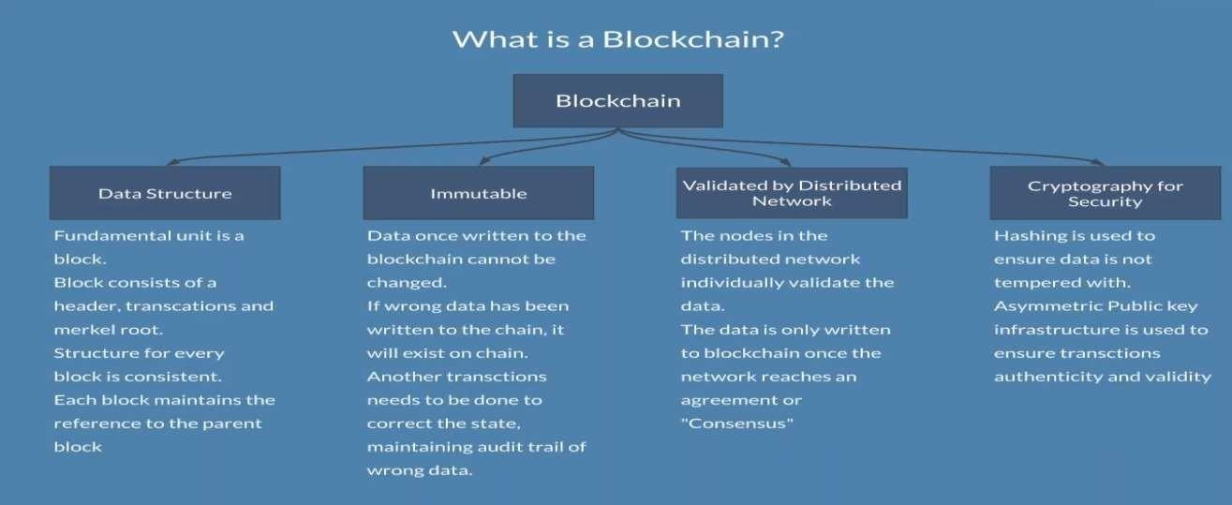
Introduction (CO1)
.

Slide 21


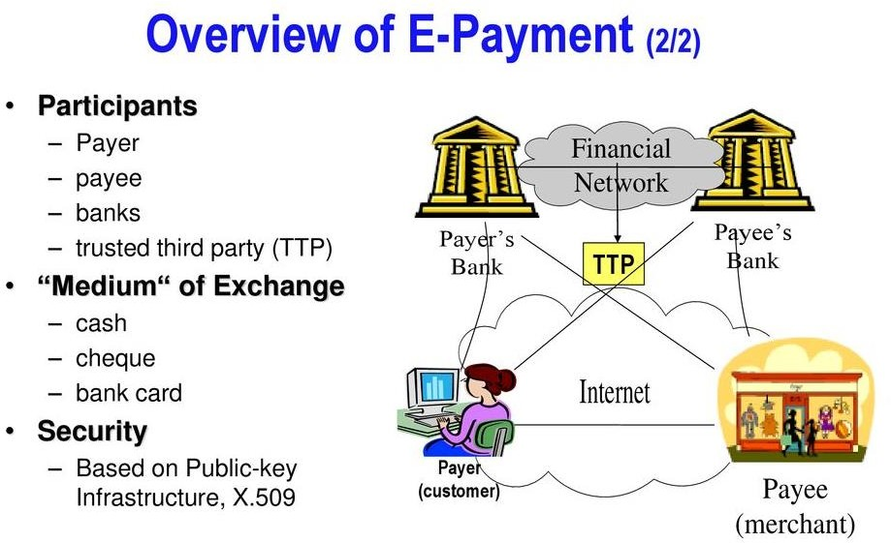
Introduction (CO1)
A ledger is a record-keeping book that stores all the transactions of an organization.
Figure 1.4 Ledger
Problems with the current system
Banks and other third parties take fees for transferring money
Mediating costs increases transaction costs
Minimum practical transaction size is limited;
Financial exchanges are slow. Checking and low cost wire services take days to complete
System is opaque and lacks transparency and fairness
Also, central authority in control can overuse the power and can create money as per their own will
Figure 1.5 Traditional payments
3

Slide 22
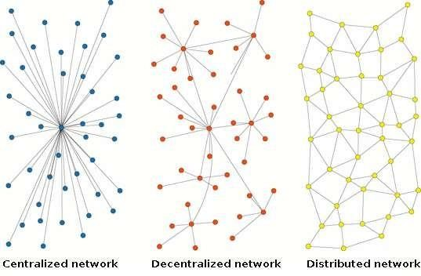
Introduction (CO1)
We need a system which:
Eliminates the need of middlemen or Third parties thereby making transaction costs nil or negligible.
Enhance transaction execution speeds and can facilitate instant reconciliation.
Is transparent and tamper resistant in order to avoid manipulation or misuse.
Currency creation is not in control of any central authority.
Is regulated to maintain the value of the currency.

Slide 23
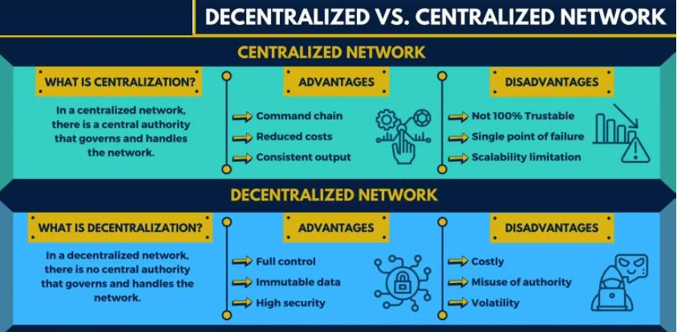
Introduction (CO1)
Distributed system enables a network of computers to maintain a collective bookkeeping via internet this is open and is not in control of one party. it is available in one ledger which is fully distributed across the network.

Slide 24
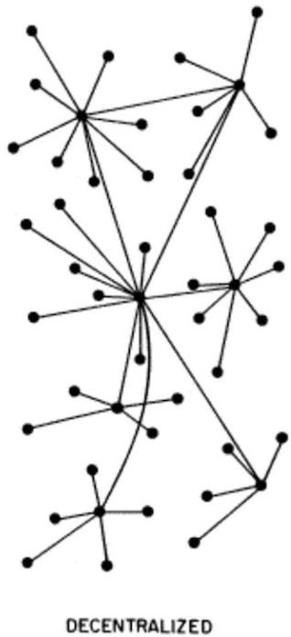
Introduction (CO1)
Most of the Internet applications we use every day are centralized, they are owned by a particular company or person that provision and maintain the source code to execute on a computer, server or maybe even a cluster.
Decentralized Applications

Slide 25
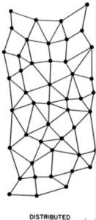
Introduction (CO1)
Decentralized means no node is instructing any other node as to what to do.
The code runs on a peer-to-peer network of nodes and no single node has control over the dApp.
Depending on the functionality of the dApp, different data structures can be used to store the application data.
Bitcoin uses a blockchain decentralized ledger of transactions.
Distributed Applications
Applications in which computation is distributed across components, communicate and coordinate their actions by passing messages. The components interact with each other in order to achieve a common goal.
Some distributed applications examples are:
CDN
AWS
Cloud Instances
Google, Facebook, Netflix, etc

Slide 26
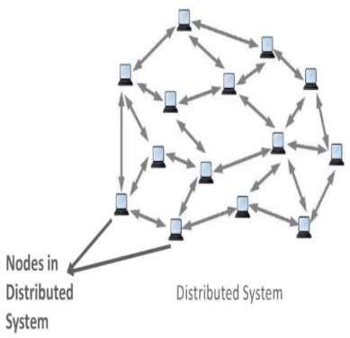
Introduction (CO1)
A System where two or more nodes work with each other in a coordinated fashion in order to achieve a common outcome .It’s modeled in such a way that end users see it as a single logical platform.

Slide 27
Introduction (CO1)
What is a node ?
A node can be defined as an individual processing unit in a distributed system
All nodes are capable of sending and receiving messages to and from each other.
Introduction – Blockchain
Blockchain technology is a distributed ledger technology originally proposed for the crypto-currency Bitcoin.
FEATURES
Immutable and tamper-proof data store
Sequential Chain with Cryptographic hashing
Trust-free Consensus-based transactions
Decentralized peer-to-peer network
Distributed shared ledger What is Blockchain?
A blockchain is a decentralized, distributed public ledger where all transactions are verified and recorded.
Blockchain is a system comprised of..
Transactions Immutable ledgers Decentralized peers Encryption processes Consensus mechanisms
Optional Smart Contracts

Slide 28
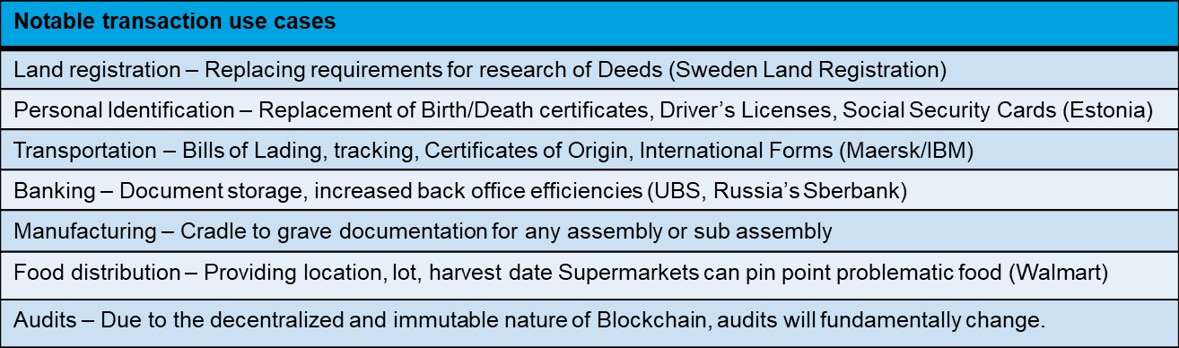
Introduction (CO1)
Immutable
As with existing databases, Blockchain retains data via transactions.
The difference is that once written to the chain, the blocks can be changed, but it is extremely difficult to do so. Requiring rework on all subsequent blocks and consensus of each.
The transaction is, immutable, or indelible
In DBA terms, Blockchains are Write and Read only
Like a ledger written in ink, an error would be resolved with another entry.
Decentralized Peers
Rather than the centralized “Hub and Spoke” type of network, Blockchain is a decentralized peer to peer network. Where each NODE has a copy of the ledger.

Slide 29
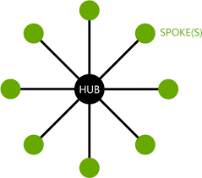
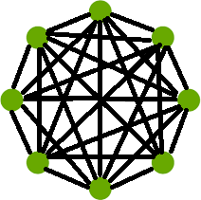
Introduction (CO1)
Legacy Network Vs Centralized DB
Blockchain Network Distributed Ledgers

Slide 30
Introduction (CO1)
Private Blockchains employ user rights for visibility, e.g. Customer – Writes and views all data
Auditors – View all transactions
Supplier A – Writes and views Partner A data Supplier B – Writes and views Partner B data Consensus
Ensures that the next block in a blockchain is the one and only version of the truth.
Keeps powerful adversaries from derailing the system and successfully forking the chain
consensus algorithm is a process in computer science used to achieve agreement on some information among the distributed systems.
The consensus algorithm was designed for the blockchain technology to achieve reliability in a blockchain network having multiple nodes.

Slide 31

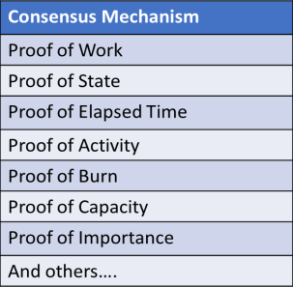
Introduction (CO1)

Slide 32
Introduction (CO1)
Smart Contracts Computer code Provides business logic layer prior to block submission.
Blockchain | Smart Contracts? | Language
Bitcoin | No
Ethereum | Yes | Solidity
Hyperledger | Yes | Various GoLang, C++, etc, depends
Others | Depends | Depends

Slide 33
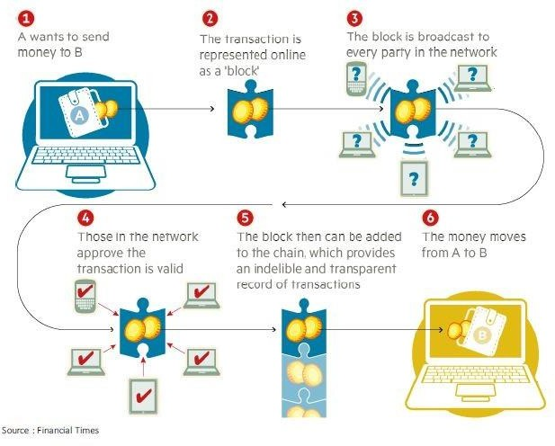
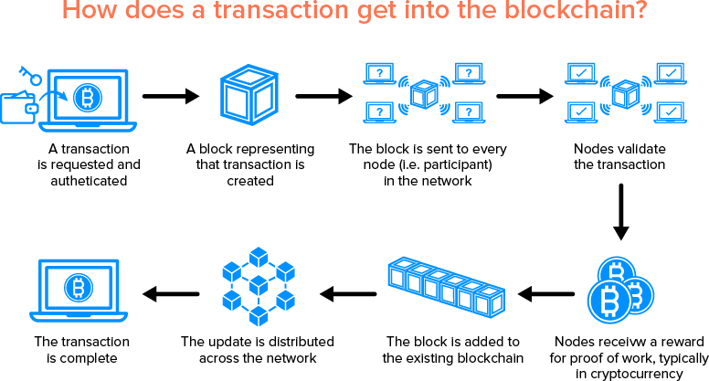
Introduction (CO1)
How Blockchain Works?

Slide 34
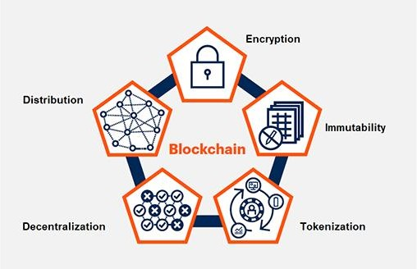
Introduction (CO1)
Elements of blockchain has five elements: Distribution, encryption, immutability, tokenization and decentralization.

Slide 35
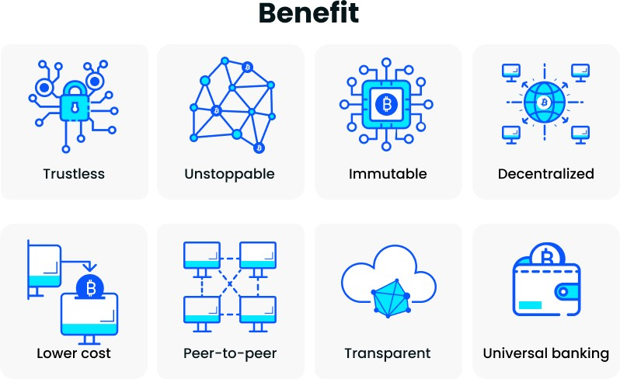
Introduction (CO1)
Distribution: Blockchain participants are located physically apart from each other and each node copy of a ledger that updates with new transactions as they occur.
Encryption: Blockchain uses technologies such as public and private keys to record the data in the blocks securely.
Immutability: Completed transactions are cryptographically signed, time-stamped and sequentially added to the ledger.
Tokenization: Transactions and other interactions in a blockchain involve the secure exchange of value.
Decentralization:Both network information and the rules for how the network operates are maintained by nodes due to consensus mechanism.
Benefits of Blockchains
Benefits of Blockchains Over Traditional Finance

Slide 36
Introduction (CO1)
Trustless: The blockchain is immutable and automates trusted transactions between counterparties who do not need to know each other. Transactions are only executed when programmed conditions are met by both parties.
Unstoppable: Once the conditions programmed into a blockchain protocol are met, an initiated transaction cannot be undone, changed, or stopped. It’s going to execute and nothing – no bank, government, or third party – can stop it.
Immutable: Records on a blockchain cannot be changed or tampered.
A new block of transactions is only added after a complex mathematical problem is solved and verified by a consensus mechanism. Each new block has a unique cryptographic key resulting from the previous block’s information and key being added into a formula.
Decentralized: No single entity maintains the network. Unlike centralized banks, decisions on the blockchain are made via consensus. Decentralization is essential because it ensures people can easily access and build on the platform.
Lower Cost: In the traditional finance system, you pay third parties like banks to process transactions. The blockchain eliminates these intermediaries and reduces fees, with some systems returning fees to miners and stakers.
Peer-to-Peer: Cryptocurrencies like Bitcoin, let you send money directly to anyone, anywhere in the world, without an intermediary like a bank charging transaction or handling fees.

Slide 37
Introduction (CO1)
Transparent: Public blockchains are open-source software, so anyone can access them to view transactions and their source code. They can even use the code to build new applications and suggest improvements to the code. Suggestions are accepted or rejected via consensus.
Universal Banking: anyone can access the blockchain to store money, it’s a great way to protect against theft that can happen due to holding cash in physical locations.
Use cases
Dubai has been able to integrate blockchain into eight industry sectors
Real estate
Tourism
Security
Transportation
Finance
Health
Education.
The end result is to become the world’s first blockchain city.
Cryaptocurrency
Cryptocurrency is a form of currency that exists solely in digital form.
Cryptocurrency can be used to pay for purchases online without going through an intermediary, such as a bank, or it can be held as an investment.
Example : Bitcoin, Etherium etc
How Do You Buy Crypto?
You can buy cryptocurrencies through crypto exchanges, such as Coinbase, Kraken or Gemini. In addition, some brokerages, such as WeBull and Robinhood, also allow consumers to buy cryptocurrencies.

Slide 38
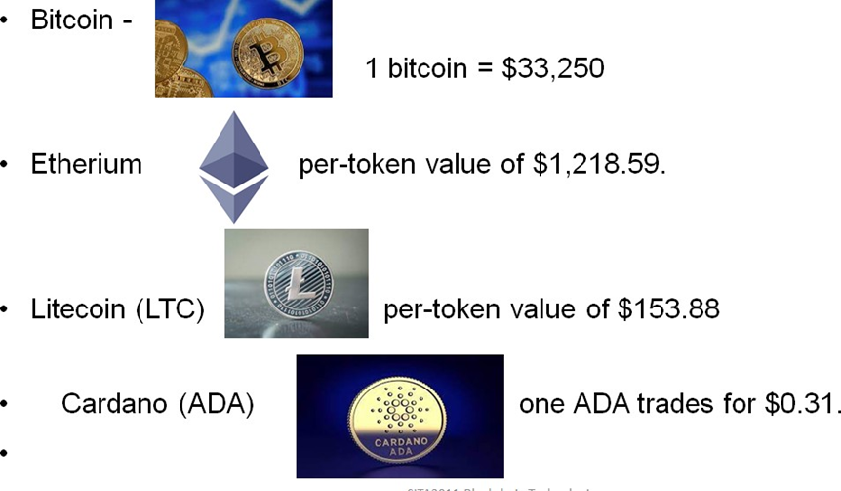
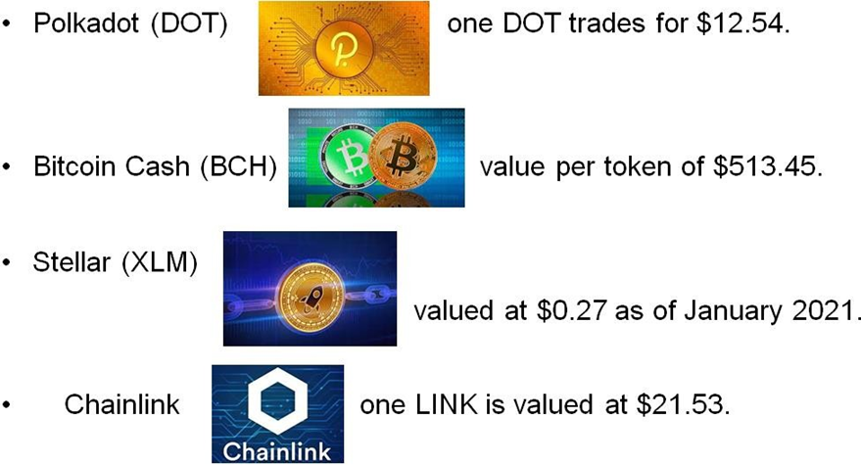
Introduction (CO1)

Slide 39

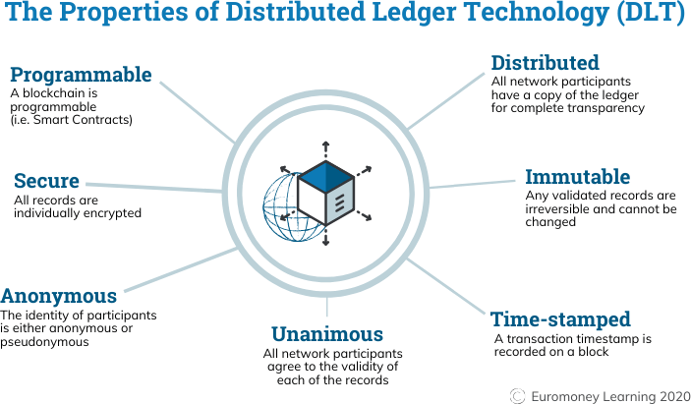
Public Ledger Shared Ledger
1.2 Public Ledger Shared Ledger
Records all transactions across business network
Shared between participants
Participants have own copy through replication
Permissioned, so participants see only appropriate transactions
It is the shared system of record.

Slide 40
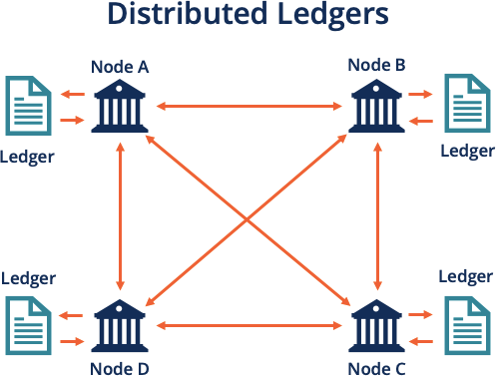
Distributed Ledgers
1.2 Blockchain as public ledger
How Distributed Ledgers Work

Slide 41
Distributed Ledgers(CO1)
Distributed ledgers are held, reorganized, and controlled by individuals called nodes.
The database is constructed independently by each node.
Every transaction occurring on the network is processed, and a conclusion on the development of the database is created by each node.
Based on the transaction, voting is carried out on the changes completed on the database. All nodes participate in the voting, and if at least 51% of them agree, the new transaction is accepted on the database.
Afterward, the nodes update the versions of the database so that all the devices or nodes will be of the same version.
The new transaction is written onto a block on the blockchain.
Nodes in Proof-of-Work blockchain are also called miners.
When a miner successfully puts a new transaction into a block, they receive a reward.

Slide 42
Distributed Ledgers (CO1)
It requires a dedicated 24×7 computer power.
It is the responsibility of miners to compute the cryptographic hash for new blocks.
Whoever, among the miners, successfully finds the hash first, gets the reward.
Miners dedicating more computational power to find the hash will be more successful.
However, as blocks keep generating, it becomes more difficult to find subsequent hash scales.
The goal is to keep a constant speed of generating the blocks.
Benefits of Distributed Ledgers
Highly transparent, secure, tamper-proof, and immutable. After records are written into distributed ledgers, they cannot be altered by any other party.
The need for a third party is eliminated
Inherently decentralized
Highly transparent

Slide 43
Advantages of Distributed Ledgers (CO1)
Advantages of Distributed Ledgers
It is secure because there is no third-party intervention.
It is immutable once recorded cannot be intervened.
The data is distributed so it is tamper-proof.
Disadvantages of Distributed ledger:
The distributed ledger is spread along with the nodes so making it vulnerable to attack.
The transaction cost is high because of a larger network.
The transaction speed is low because of the operation of a large number of nodes.

Slide 44
Types of the Block Chain
Types of blockchain
Public Blockchains
Private Blockchains
Consortiums Blockchains
Hybrid Blockchains Public Blockchains
Public blockchains are open, decentralized networks of computers accessible to anyone wanting to request or validate a transaction (check for accuracy).
Those (miners) who validate transactions receive rewards.
Public blockchains use proof-of-work or proof-of-stake consensus.
permission-less distributed ledger system.
Anyone who has access to the internet can sign in on a blockchain platform to become an authorized node and be a part of the blockchain network.
Example : Bitcoin and Ethereum (ETH) blockchains.

Slide 45
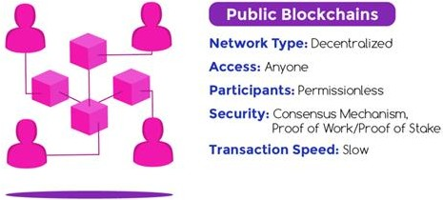
(CO1)
A public blockchain has some characteristic features:
Write-only, immutable, transparent data storage.

Slide 46
Introduction (CO1)
It brings trust among the whole community of users
Decentralized, no need for intermediaries.
Consistent state across all participants.
Resistant against malicious participants.
Anyone can join the public blockchain.
Disadvantages
They suffer from a lack of transaction speed.
Private Blockchains
A Private Blockchain is just like a relational database i.e. fully centralized and owned by a single organization.
Private blockchains are not open, they have access restrictions.
People who want to join require permission from the system administrator.
They are typically governed by one entity, meaning they’re centralized.
For example, Hyperledger is a private, permissioned blockchain.

Slide 47
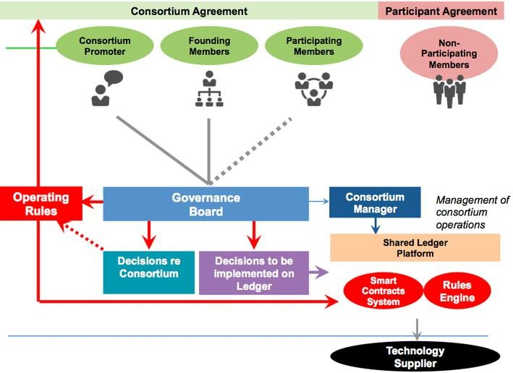
(CO1)
Consortiums blockchain

Slide 48
Hybrid Blockchain (CO1)
Validation is conducted by known and identified members of the limited network of nodes
greater privacy since the information from verified blocks is not exposed to the public.
There are no transaction fees
consensus is reached by a relatively small number of nodes in accordance to the governance scheme.
Increased scalability - Bitcoin’s block transmits only up to 1 Mb* (from 1500 to 2700 transactions) per 10 minutes, when a consortium blockchain can optimize it to 1000 and more transactions per second.
A consortium platform is more flexible.
voting-based system, it ensures low latency and superb speed.
Hybrid Blockchain
like a consortium blockchain, but it is not.
Hybrid blockchain is best defined as a combination of a private and public

Slide 49
Introduction (CO1)
blockchain.
It has use-cases in an organization that neither wants to deploy a private blockchain nor public blockchain and simply wants to deploy both worlds’ best.
Example of Hybrid Blockchain: Dragonchain, XinFin’s Hybrid blockchain
Advantages
Works in a closed ecosystem without the need to make everything public.
Rules can be changed according to the needs.
Hybrid networks are also immune to 51% attacks.
It offers privacy while still connected with a public network.
It offers good scalability compared to the public network.
Disadvantages
Not completely transparent.
Upgrading to the hybrid blockchain can be a challenge.
There is no incentive for participating and contributing to the network.

Slide 50
Cryptocurrency (CO1)
Cryptocurrency works on the principle of BlockChain Technology, that is why, BlockChain is the most trending item of current era, due to it’s secure nature cryptocurrency is widely accepted. It’s value is increasing day by day. Many oil industries, IBM Technologies, Mercedes Benz, Swiss Bank, Samsung, and even Google is planning to launch their own ryptocurrency in 2019 for safe and secure transactions. Now, this technology is disrupting almost every marketshare due to its popularity and demand in the world. Satoshi Nakamoto introduced the concept of BlockChain in 2008 in the form of cryptocurrency BitCoin.
It’s function is to allow users to secure and control their monetary values so that no third party like government or banks would be able to access or control it. It is a process to carry everyone to the highest grade of liability.
Three technologies work behind the BlockChain Technology-
Private Key Cryptography
Peer 2 Peer Network
BlockChain’s Protocol Program Private Key Cryptography
Peer 2 Peer Network
BlockChain’s Protocol Program

Slide 51
What Is a Permissioned Blockchain? (CO1)
A permissioned blockchain is a distributed ledger that is not publicly accessible. It can only be accessed by users with permissions. The users can only perform specific actions granted to them by the ledger administrators and are required to identify themselves through certificates or other digital means.
You might consider the addition of permissioned users as an extra blockchain security system. Administrators maintain an access control layer to allow certain actions to be performed only by certain identifiable participants. Records are kept within the blockchain of who is involved in the transactions. This makes permissioned blockchains different from public blockchains.

Slide 52
Understanding Permissioned Blockchains (CO1)
A blockchain can be built and accessed in multiple ways. Some blockchains need special permissions to read, access, and write information. Others only require that you have the ability to connect and can conduct work for the network. The intrinsic configuration of each blockchain controls the participants' transactions and defines their roles in which each participant can access and contribute to the blockchain.
It may also include maintaining the identity of each blockchain participant on the network. Such blockchains are called permissioned blockchains.

Slide 53
Understanding Permissioned Blockchains (CO1)
Difference Between Permissionless and Permissioned Blockchains
Permissioned blockchains are similar to permissionless blockchains because they use the same technologies. However, permissioned blockchains do not allow users to access the blockchain without identification.
For example, a bank may be running a permissioned blockchain operated through a designated number of nodes internal to the bank to track money transfers. You cannot access this blockchain because you don't have the permissions required. In contrast, you could join a permissionless blockchain like a cryptocurrency mining network once you have established a semi-anonymous account in that network.

Slide 54
Understanding Permissioned Blockchains (CO1)
Much of the inner workings of the blockchains are the same. The key differences between them are:
Enterprise vs. Public use
Decentralization
Development
Transparency

Slide 55
Cryptographic Hash Function(CO1)
Cryptographic Hash Function: Hashing is a method of applying a cryptographic hash function to data, which calculates a relatively unique output (called a message digest, or just digest).
Important security properties are:
a. They are preimage resistant. This means that they are one-way; it is computationally infeasible to compute the correct input value given some output value
b. They are second preimage resistant. cryptographic hash functions are designed so that given a specific input, it is computationally infeasible to find a second input which produces the same output
c. They are collision resistant. [This means that one cannot find two inputs that hash to the same output.] for an input of nearly any size

Slide 56
Cryptographic Hash Function(CO1)
2. Cryptographic Nonce •A cryptographic nonce is an arbitrary number that is only used once. •A cryptographic nonce can be combined with data to produce different hash digests per nonce: hash (data + nonce) = digest •Only changing the nonce value provides a mechanism for obtaining different digest values while keeping the same data. •This technique is utilized in the (proof of work) consensus model
3. Transactions •Transaction represents an interaction between parties. •With cryptocurrencies, for example, a transaction represents a transfer of the cryptocurrency between blockchain network users. •For business-to-business scenarios, a transaction could be a way of recording activities occurring on digital or physical assets

Slide 57

Cryptographic Hash Function(CO1)
3. Asymmetric Key Cryptography
4. Addresses and Address Derivation:
• Some blockchain networks make use of an address, which is a short, alphanumeric string of characters derived from the blockchain network user’s public key using a cryptographic hash function, along with some additional data (e.g., version number, checksums).
• Most blockchain implementations make use of addresses as the “to” and “from” endpoints in a transaction.
• These Addresses are shorter than the public keys and are not secret. • One method to generate an address is to create a public key, applying a cryptographic hash function to it, and converting the hash to text.
• public key cryptographic hash function address

Slide 58
Cryptographic Hash Function(CO1)
•Each blockchain implementation may implement a different method to derive an address.
•For permissionless blockchain networks, which allow anonymous account creation, a blockchain network user can generate as many asymmetric-key pairs, and therefore addresses as desired, allowing for a varying degree of pseudo-anonymity.
•Addresses may act as the public-facing identifier in a blockchain network for a user, and oftentimes an address will be converted into a QR code
5. Private Key Storage : •Users must manage and securely store their own private keys
•Instead of recording them manually, they often use software to securely store them.
•This software is often referred to as a wallet.

Slide 59
(CO1)
The wallet can store private keys, public keys, and associated addresses.
•It may also perform other functions, such as calculating the total number of digital assets a user may have.
•If a user loses a private key, then any digital asset associated with that key is lost, because it is computationally infeasible to regenerate the same private key.
•If a private key is stolen, the attacker will have full access to all digital assets controlled by that private key 6. Ledgers
•It is a collection of transactions
•Throughout history, pen and paper ledgers have been used to keep track of the exchange of goods and services.
•In modern times, ledgers have been stored digitally, often in large databases owned and operated by a centralized trusted third party

Slide 60
Merkle Tree​ (CO1)
Merkle Tree​
The Merkle Tree takes its name from the mathematician Ralph Merkle. The discovery was that much information can be represented in a single hash. For this, the data itself is first hashed. Then the hashes are hashed again and merged. Finally, the Merkle Tree is merged into a single hash. This last hash is also called the root hash, the root of the tree. It represents all the information of its “leaves” (individual transactions) and “branches” (hashes of the leaves) in a relatively short string.​
​
Creating the root hash is quick and easy, as long as all branches and leaves are known. We remember the function of a hash function: it works clearly and quickly in one direction and is impossible to break down in the other direction. If the root hash is known, but the transactions are unknown, it is impossible to guess the transactions.​
​
A root hash alone is therefore not enough, and the rest of the block must be saved. Thus, the miner can validate the root hash at any time by hashing the information contained in the block again. As long as the hash function is the same, the miners always get the same hash for a given input of data. This is very handy because they can only check if they are on the same level as the hash.​
​

Slide 61
(CO1)
In this context, it is easier to understand the mining of the proof of work. When mining, the block header of the block is incrementally changed to get a special hash. The header consists of five constants and one variable. The constants are the version number of the software, the hash of the previous block, the root hash of the Merkle tree, the timestamp, and the target size of the searched hash in bytes.​
​
The variable is the nonce. A nonce is a number raised by one. Then the miner hashes the data and checks if the data results in a hash that is below the searched target value. If the hash value is greater than the target, the miner repeats the process; So it increases the nonce by one, hashes and checks again. It repeats this until it finds a hash below the target, or it gets another block from another networker whose hash is below the target. Then takes this new block and uses it as the basis for the next block (using the new hash as the “hash of the previous block”).​
​

Slide 62
(CO1)
Mining is a hyper-repetitive process whose goal is to find a special hash. Once the hash is found, the game starts again. The probability of finding a special hash depends on the difficulty. On average Bitcoin finds a new block every ten minutes. The difficulty keeps adapting, so this average stays the same.​
​
The special feature of this process is that the special hash can only be found by guessing. This rate costs computing power and therefore energy. A look at the special hash is enough to see that it is special because it begins with zeros.​
Here is an example of such a hash from the Bitcoin blockchain: 000000000000000000094bfa4edb1245c347e42452e4418e9fe5a1d24e335b16​
​
​
Hashes: The matryoshka of the blockchain​
A block can be simplified as a matryoshka image. The smallest doll is the unhashed transaction. The next envelope is the hashed form of this transaction. Thereafter, two hashed transactions are hashed together. So the hashes are merged more and more. In the end, there is only one hash remaining, the root hash, or the biggest matryoshka.​

Slide 63
(CO1)
Cryptographic hashes and standard digital signatures that are essential for ensuring the blockchain as a globe ledger with tamper-proof, public verifiability and achievable consensus. While the latter category, mainly used for enhancing the privacy and anonymity of blockchain-based transactions, covers some special signatures (such as ring signatures), commitments, accumulato
Special signature primitives for blockchains: To enhance the privacy and anonymity of transactions, some advanced signature primitives such as ring signature and multi-signature are also widely applied in blockchains.rs, zero-knowledge proofs and so on.
1.Ring signatures : Anonymity is always required in information systems (Shen et al., 2018), especially in the e-cash system. However, Bitcoin can only provide pseudonymity due to the linkability of transactions. Therefore, many new alternative cryptocurrencies have been proposed to address this problem. From a perspective of cryptography, there are many kinds of signatures for achieving anonymity, such as blind signature (Chaum, 1982), ring signature (Rivest et al., 2001), group signature (Chaum and van Heyst, 1991) and DC-nets (Chaum, 1988). However, only ring signature and its variants have been used in blockchains for anonymity.
2. One-time (ring) signatures: Lamport in 1979 (Lamport, 1979) proposed the concept of one-time signature (OTS), where the signing key can be used securely but only once, and the signing key would be revealed if it is used twice or more. OTS is frequently used as a building block in constructions of encryptions and authenticated key agreements.
3. Borromean (ring) signatures: Another interesting primitive related to ring signature and blockchain is the so-called Borromean (ring) signature (BRS), proposed by Maxwell and Poelstra in 2015 (Maxwell and Poelstra, 2015). Poelstra (Poelstra, 2017) claimed that BRS is now used in Elements (Element, 2015), Liquid (Liquid) and Monero.
4. Multi-signatures: The primitive of multi-signature allows a single signature to work as several ordinary signatures on the same message. One of the critical requirements of multi-signature is that the single signature has the same size as one regular signature.

Slide 64
Introduction (CO1)
Assymetric cryptography: Public Key Cryptography or in short PKI is also known as asymmetric cryptography. It uses two pairs of keys - public and private. A key is a some long binary number.
The public key is distributed worldwide and is truly public as its name suggests. The private key is to be strictly held private and one should never lose it. In case of Bitcoin, if you ever lose the private key to your Bitcoin wallet, the entire contents of your wallets would be instantly vulnerable to theft and before you know it, all your money (the contents of your wallet) would be gone with no mechanism in the system to trace out who stole it - that is the anonymity in the system that I mentioned earlier.
The PKI accomplies two functions - authentication and the message privacy through encryption/decryption mechanism. I will now explain both these functions Authentication When the two parties exchange messages, it is important to establish a trust between the sender and the receiver. Especially, the receiver must trust the source of message. Going to our earlier scenario (depicted in Figure 1) of Bob sending some money to Lisa for purchasing of some goods from her, let us see how the PKI builds this trust between Bob and Lisa. Look at below image

Slide 65
(CO1)
In the first place, if Bob wants to send some money to Lisa, he has to create a private/public key of its own. Note that both keys are always paired together and you can not mix the private and public keys of different individuals or different instances. Now, Bob says that he is sending $10 to Lisa. So he creates a message (a plain-text message) containing Bob’s (sender) public key, Lisa’s (receiver) public key, and the amount ($10). The purpose of this remittance such as “I want to buy pumpkin from you” is also added into the message.
The entire message is now signed using Bob’s private key. When Lisa receives this message, she will use the signature verification algorithm of PKI and Bob’s public key to ensure that the message indeed originated from Bob. How the PKI works is beyond the scope of this tutorial. The interested reader is referred to this site for a more detailed discussion on PKI. This establishes the authenticity of the message originator.
Now, let us look at the message privacy Message Privacy: Now, as Lisa has received her payment, she wants to send the link to her ebook which Bob wants to buy. So Lisa would create a message and send it to Bob as shown in image

Slide 66
Faculty Video Links, Youtube & NPTEL Video Links and Online Courses Details
Youtube/other Video Links
https://www.youtube.com/watch?v=SSo_EIwHSd4&vl=en
https://www.youtube.com/watch?v=RT7x0lQvSLk
https://www.youtube.com/watch?v=yubzJw0uiE4
https://www.khanacademy.org/economics-finance-domain/core-finance/money-and-banking/bitcoin/v/bitcoin-transaction-block-chains

Slide 67
Daily Quiz
What does P2P stand for?
What is a node?
Who created Bitcoin?
Where do you store your cryptocurrency?
Where is the LEAST SAFE place to keep your cryptocurrency?
What is a miner?
What are the different types of tokens?
Where can you buy cryptocurrency?
Which is NOT a part of asymmetric encryption?
What is a block chain?

Slide 68
Weekly Assignment
1. The company you work for is considering introducing block chain technology to its administrative and financial procedures. However, not all parties involved are convinced. Even though you have explained that this innovative technology has the potential to significantly improve business transactions, you are asked to explain how smart contracts work and how they can improve contract implementation and monitoring processes.
2. Explain the process of Bitcoin mining; on what type of blockchain it is it based and how it works.
3. Which features distinguish databases from blockchain ledgers? Provide a comparative analysis of the two.
4. Analyse, using a diagram, how a distributed ledger works, present its main characteristics, and explain how it differs from a “traditional” centralized ledger.
5. Suggest which type of blockchain should be used for the security of donations in a charity organization. What benefits does the blockchain technology introduce in such a scenario? Explain your answer using an example.
Explain how blockchain can be introduced in the education system to certify the credentials of candidate teachers and ascertain the security of the pupils’ personal data.
7. Critically present and compare how smart contracts can be used in a lottery scenario.
8. How does blockchain technology prevent/ solve the problem of “Double spending” in digital currencies such as Bitcoin?

Slide 69
MCQ s
a. Cryptographic hash function takes an arbitrary block of data and returns
fixed size bit string
variable size bit string
both fixed size bit string and variable size bit string
none of the mentioned
b. ElGamal encryption system is
symmetric key encryption algorithm
asymmetric key encryption algorithm
not an encryption algorithm
none of the mentioned

Slide 70
MCQ s(Continued)
c. Voice privacy in GSM cellular telephone protocol is provided by
A5/2 cipher
b5/4 cipher
b5/6 cipher
b5/8 cipher
d. Which one of the following is a cryptographic protocol used to secure HTTP connection?
stream control transmission protocol (SCTP)
transport layer security (TLS)
explicit congestion notification (ECN)
resource reservation protocol

Slide 71
MCQ s(Continued)
e. What is a blockchain?
A distributed ledger on a peer to peer network
A type of cryptocurrency
An exchange
A centralized ledger
f. What does P2P stand for?
Password to Password
Peer to Peer
Product to Product
Private Key to Public Key

Slide 72
MCQ s(Continued)
g.What is a node?
A type of cryptocurrency
A Blockchain
A computer on a Blockchain network
An exchange
h. Who created Bitcoin?
Satoshi Nakamoto
Samsung
John Mcafee
China

Slide 73
MCQ s(Continued)
i. Where Bank account
Floppy Disk
Wallet
In your pocketdo you store your cryptocurrency?
j. Where is the LEAST SAFE place to keep your cryptocurrency?
In your pocket
On an exchange
On a hot wallet
At your work desk

Slide 74
Old Question Papers
NA

Slide 75
Expected Questions for University Exam
Q 1. What do you know about Blockchain? What is the difference between Bitcoin blockchain and Ethereum blockchain?
Q 2. What is the principle on which blockchain technology is based on?
Q 3. What are the different types of Blockchains?
Q 4. Why is Blockchain a trusted approach?
Q 5. Name the two types of records that are present in the blockchain database?
Q 6. Blockchain is a distributed database. How does it differ from traditional databases?
Q 7. What are the properties of Blockchain?
Q 8. What is encryption? What is its role in Blockchain?
Q 9. What do you mean by blocks in blockchain technology?
Q 10. How does a block is recognized in the Blockchain approach?

Slide 76
Faculty Video Links, Youtube & NPTEL Video Links and Online Courses Details
My Video :
https://youtu.be/rPD97AZ9W2U
https://youtu.be/QbBHCehF3xo
https://youtu.be/JRlJPlbOP7I
Youtube/other Video Links
https://www.youtube.com/watch?v=yubzJw0uiE4
https://www.youtube.com/watch?v=_160oMzblY8
https://www.youtube.com/watch?v=YJyXfjbBmc8
https://www.youtube.com/watch?v=ENrjn-lD1e8

Slide 77
Glosarry Questions
address
Used to send and receive transactions on a blockchain network, and to identify different users; also referred to as a ‘public key’. An address is an alphanumeric character string, which can also be represented as a scannable QR code. In Ethereum, the address begins with 0x. For example: 0x06A85356DCb5b307096726FB86A78c59D38e08ee
air-gapping
A method for securing computers in which the device does not connect to the internet or any other open networks. Many hardware wallets use air-gapping as a security mechanism to keep users’ private keys or Secret Recovery Phrase offline, and thus safer from any kind of attack.
AML (Anti-Money Laundering)
A set of international laws enacted to diminish the potential for criminal organizations or individuals to launder money. These rules and laws are applied to cryptocurrencies with varying effects in different jurisdictions.
API (Application Programming Interface)
A predefined set of requests that one program can make to another in order to transfer information between them. When you hear someone saying that an application is “getting information from” another source, it’s often doing so through an API.
ASIC (Application Specific Integrated Circuit)
ASICs are silicon chips designed to do a specific task. In ASICs used for mining cryptocurrencies, the ASIC will perform a calculation to find values that provide a desired solution when placed into a hashing algorithm.

Slide 78
Summary
A blockchain is “a distributed database that maintains a continuously growing list of ordered records, called blocks.” These blocks “are linked using cryptography. Each block contains a cryptographic hash of the previous block, a timestamp, and transaction data. A blockchain is a decentralized, distributed and public digital ledger that is used to record transactions across many computers so that the record cannot be altered retroactively without the alteration of all subsequent blocks and the consensus of the network.”

Slide 79
References
1.AndreasM.AntonopoulosandGavinWood,“Mastering Ethereum:Building Smart Contracts and DApps”, O′Reilly 2.MelanieSwan,“Blockchain:Blueprint for a New Economy”, O′Reilly
3.MattZand, Xun(Brian)Wu, and MarkAnthon,“ Handson Smart Contract Development with Hyperledger FabricV2
4. Daniel Drescher, Block chain basics A non-technical introduction in 25 steps, Apress , 2017. Paul Vigna and Michael J.Casey.
5. The Age of Cryptocurrency, 2015. Supplementary Readings: Antonopoulos, Mastering Bitcoin : Unlocking Digital Cryptocurrencies.
6. Mastering Blockchain - Imar Bashir - Second edition - Packt - 2018. Satosh Nakamoto, Bitcoin : A peer-to-peer electronic Cash system.

Slide 80
Noida Institute of Engineering and Technology, Greater Noida
Thank You

